Slide 1
Variables and Study Designs
Just a little bit

Slide 2

Example 1: 5K Race
Study:
5 K race
Subjects:
20 runners
Data:
Finishing time in minutes

Slide 3
Example 2: Choice of Food
Study: Choice of Food after finishing the run
Subjects: 20 runners
Data: Type of Food

Slide 4
Definition of Variable in Statistics
A variable is a characteristic or attribute that can be measured or observed. The value of a variable varies from one observation to another.

Slide 5
Types of Variables
Numerical (Quantitative)
Continuous
Discrete
Categorical (Qualitative)
Nominal
Ordinal
Can you draw lines to connect the correct type of variable to the given sampled data?
Can you think of some examples of each type of variable?

Slide 6

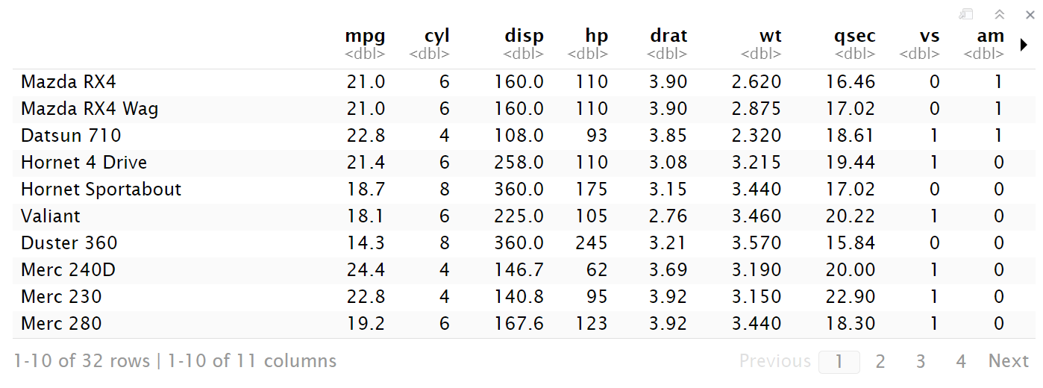

Example 3: mtcars

Slide 7
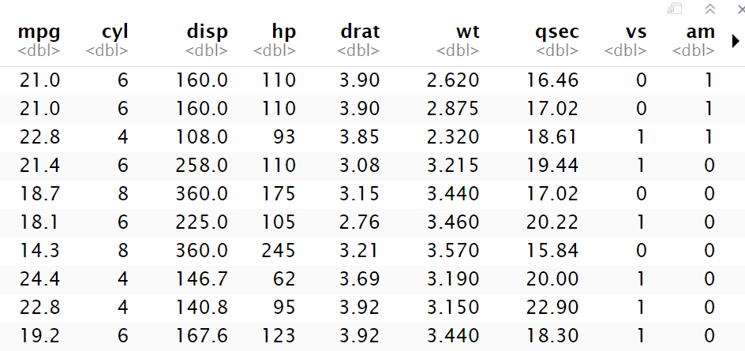
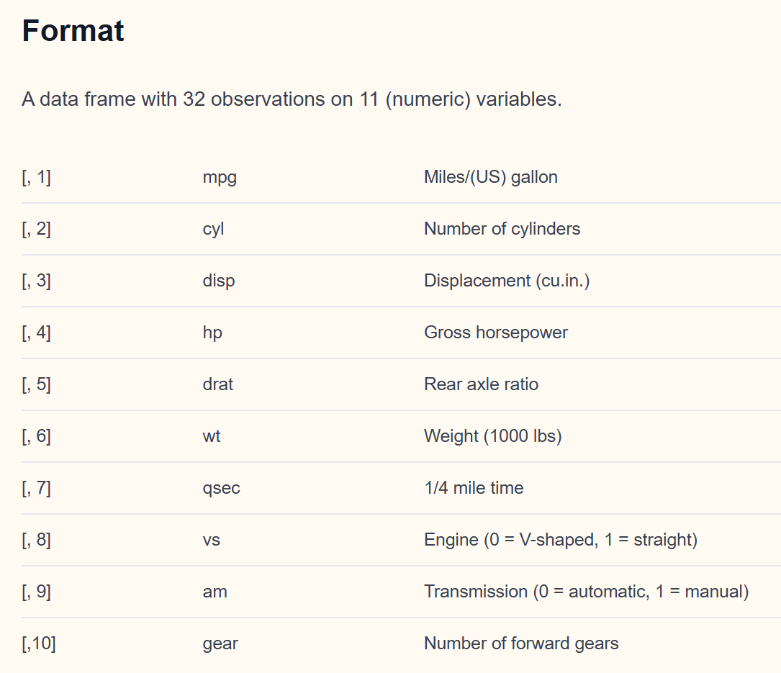
Example 3: Mtcars variables
Can you recognize the type of variables in the dataset?
https://www.rdocumentation.org/packages/datasets/versions/3.6.2/topics/mtcars

Slide 8
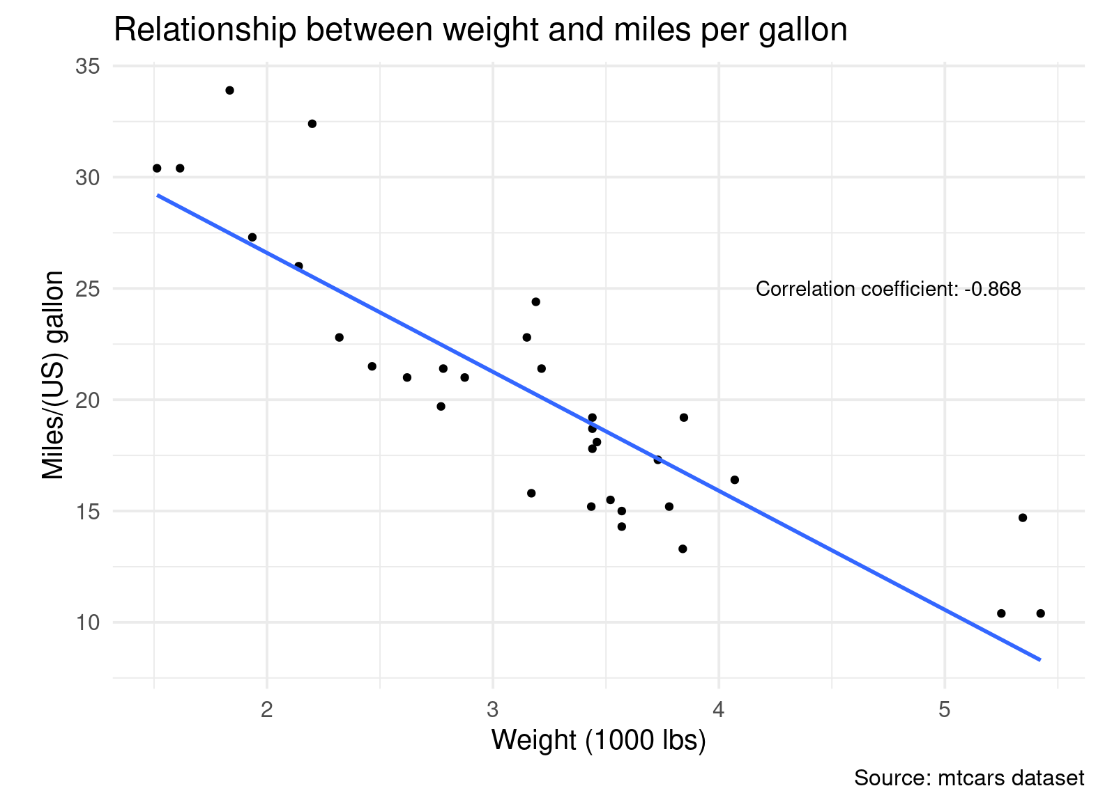
Example 3: relationship
You may want to answer the question:
Do heavier vehicles tend to have fewer mpg?

Slide 9
Roles of Variables
Response/Dependent/Output Variable (Y)
Explanatory/Independent Variable (X)
You may also hear people calling these as factors, predictors, design factors, or covariates if they are used in certain scenarios when satisfying certain conditions.

Slide 10
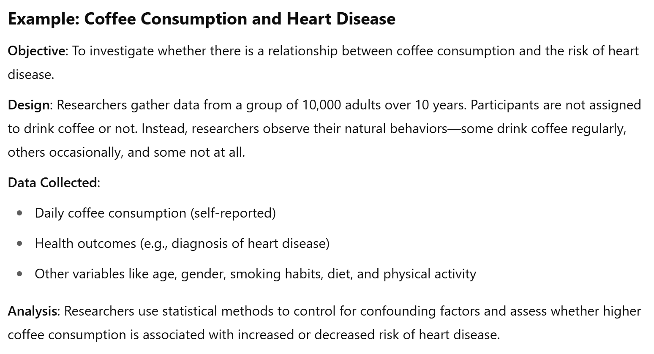
Example 4
Types of Variables?
Roles they take?

Slide 11
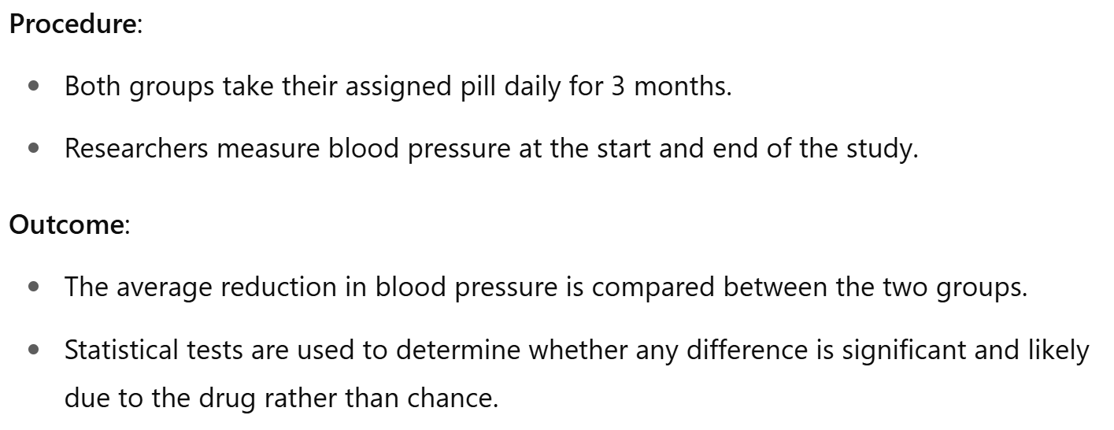
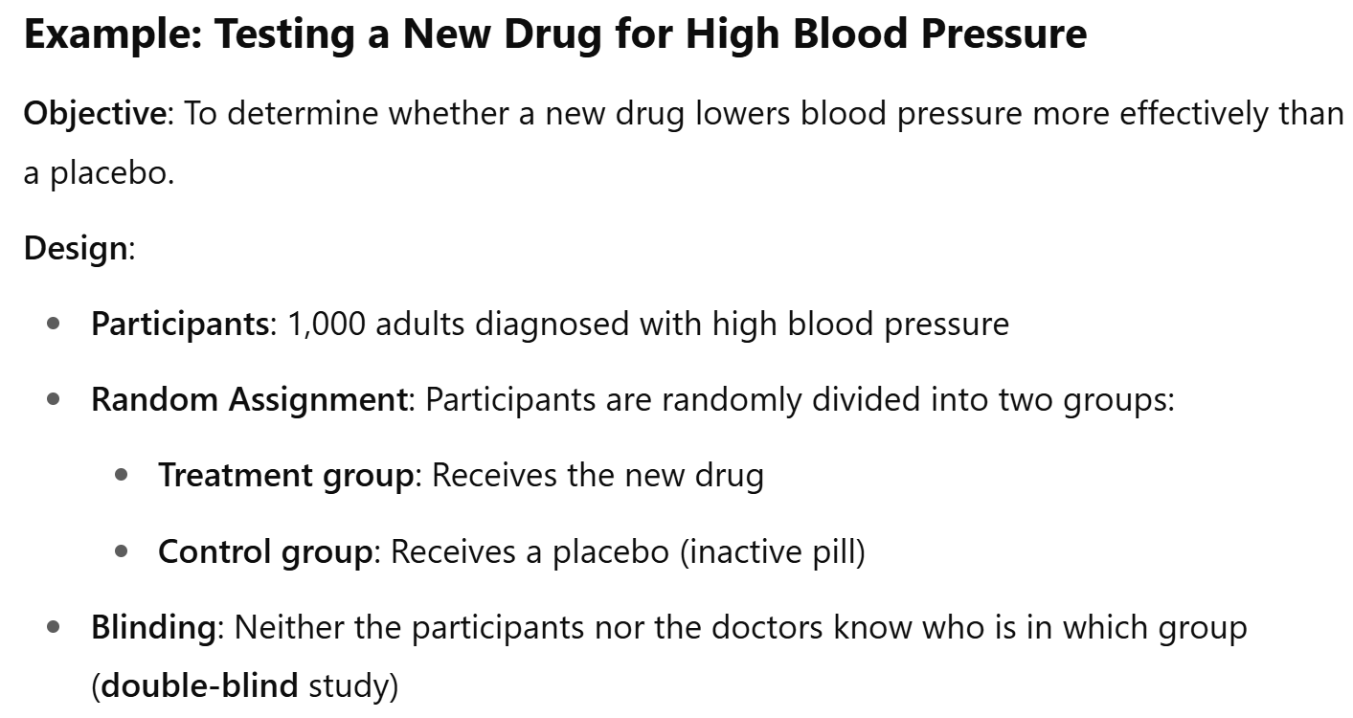
Example 5
Types of variables?
Roles they take?

Slide 12
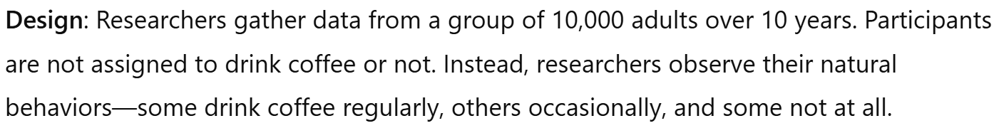
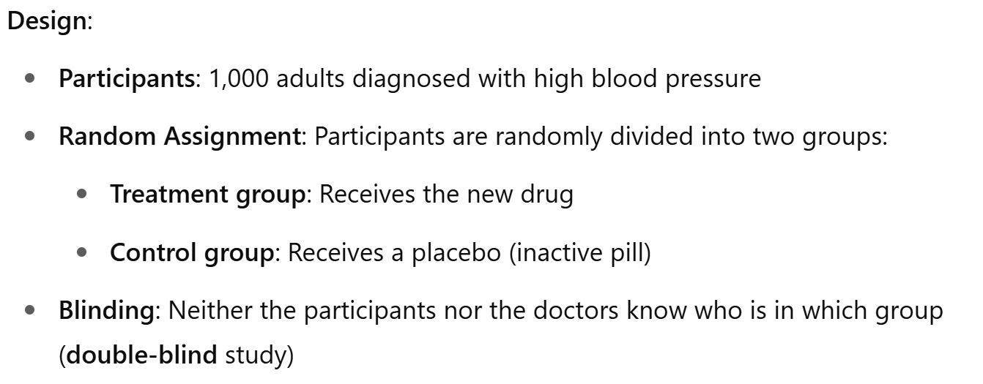
The Design of a Study

Slide 13
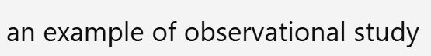
Types of Study Designs
Help me tag the design in the correct place.

Slide 14
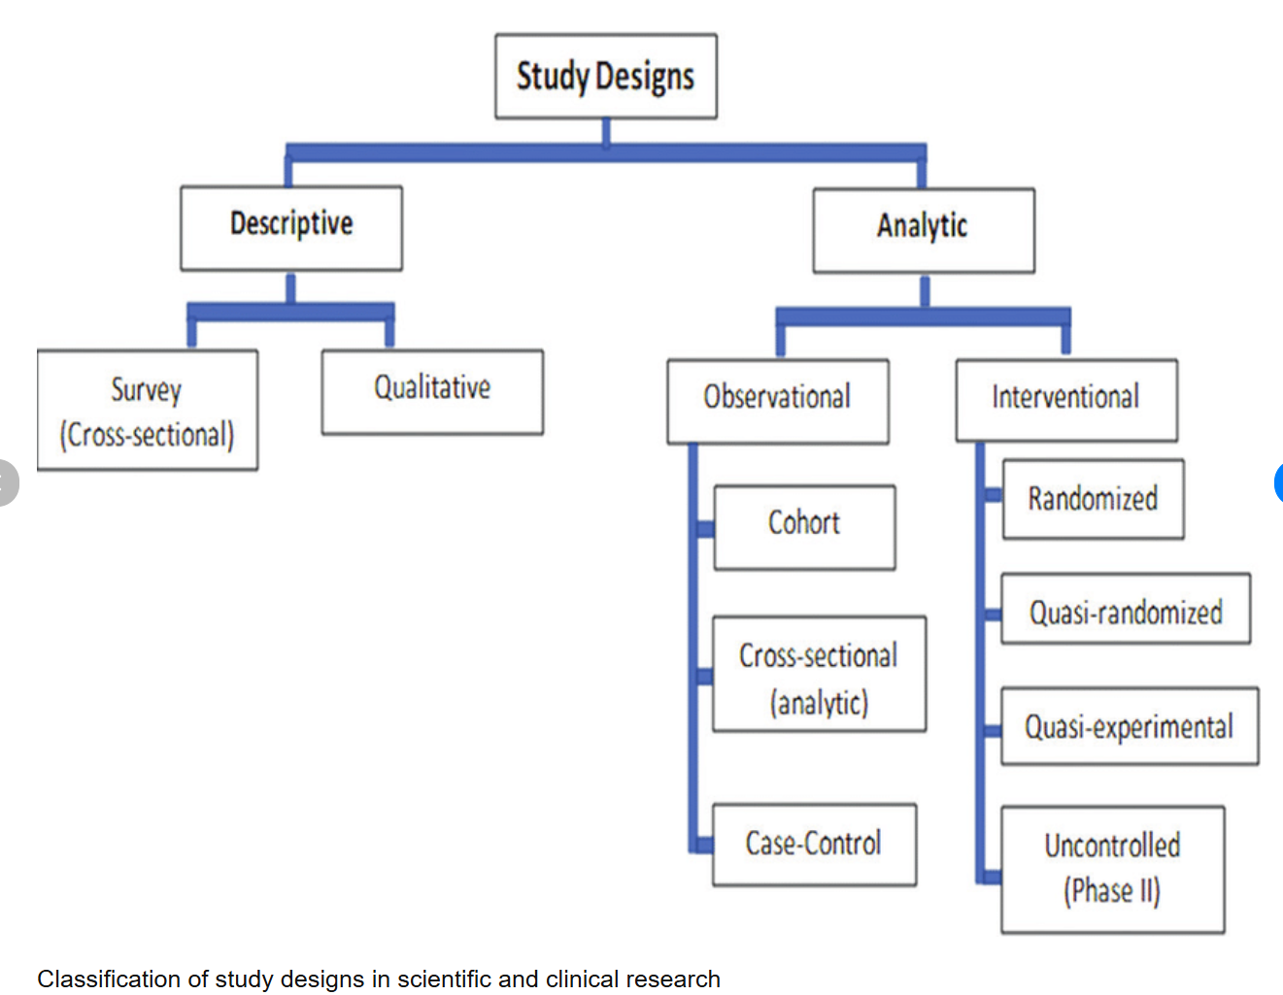
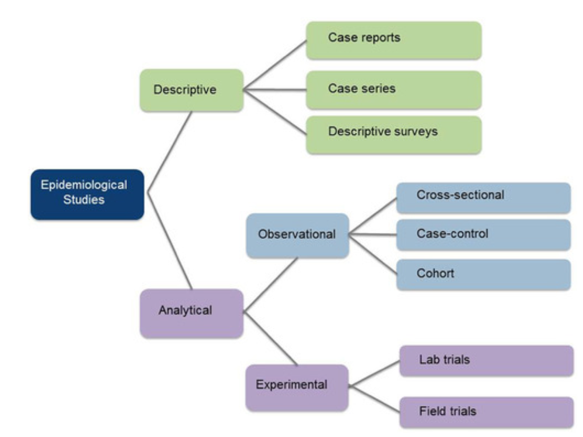
Study Design Type Let’s search for the keywords online
I randomly chose two to present here; you can browse the internet for others. They all, in general, are good.

Slide 15
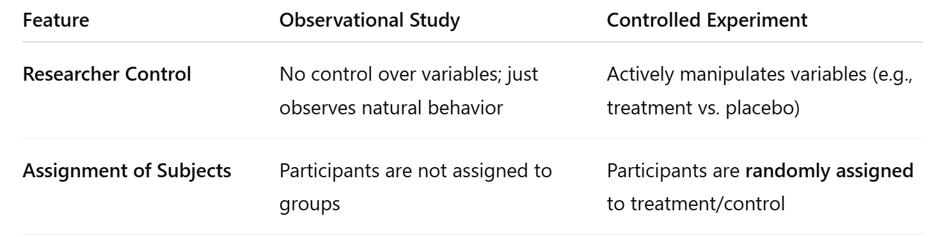
Chatgpt says about Observational study and controlled experiment

Slide 16
Types of Study Designs
How were the subjects (participants) selected?
Do we want to obtain the analysis of the selected groups only, or do we want to extend the results to a more general group?

Slide 17
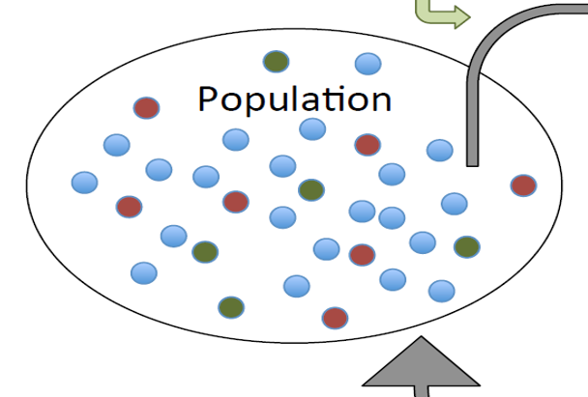
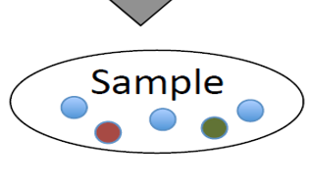
Population and Sample

Slide 18
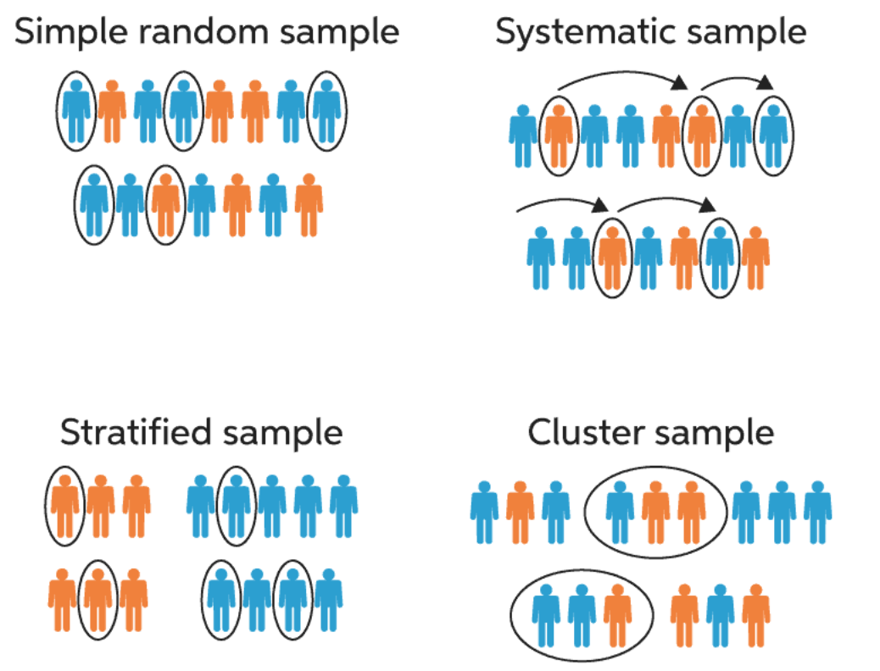
Random Sampling Methods
Simple Random Sampling
Systematic Sampling
Stratified Sampling
Cluster Sampling
……

Slide 19
Reading Assignment
Find and read about the definitions and examples of the following random sampling methods:
Simple Random Sampling
Systematic Sampling
Stratified Sampling
Cluster Sampling
Multistate Sampling
Then find and read about convenience sampling. What are the differences between the above random sampling methods and the convenience sampling method?

Slide 20


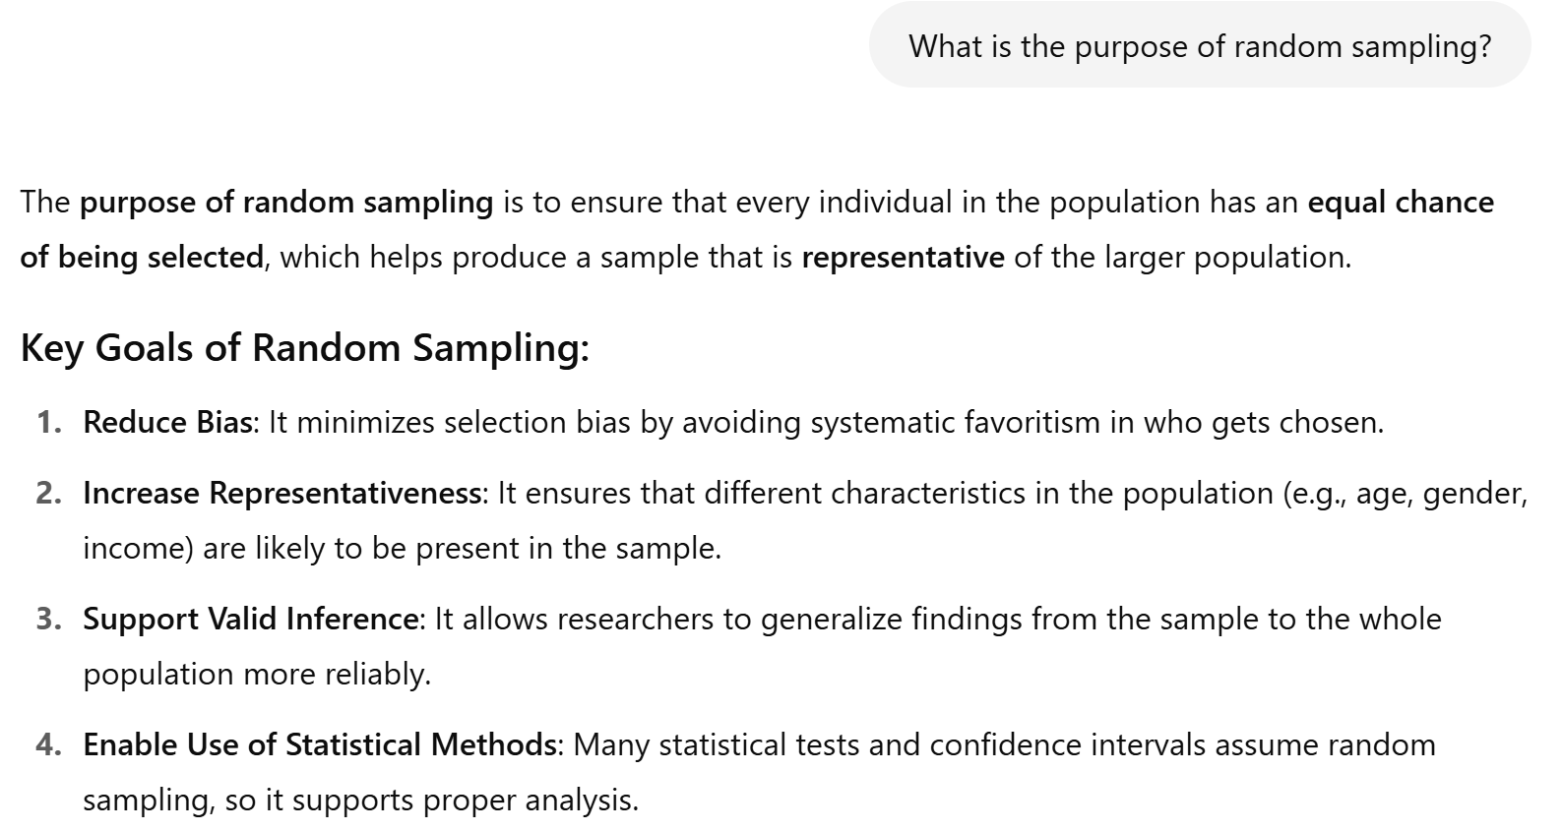

Slide 21

Why do these matter?

Slide 22
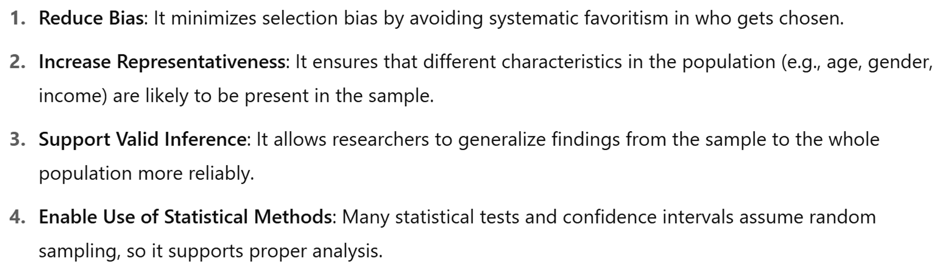
At least We know why it matters to tell the sampling method

Slide 23
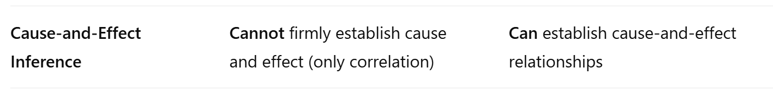
Why tell the types of Studies?

Slide 24
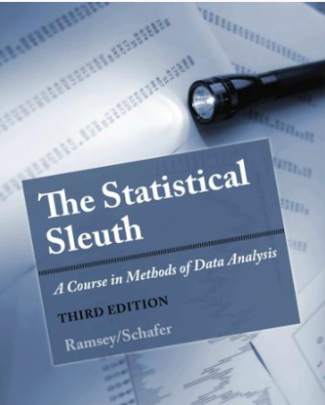
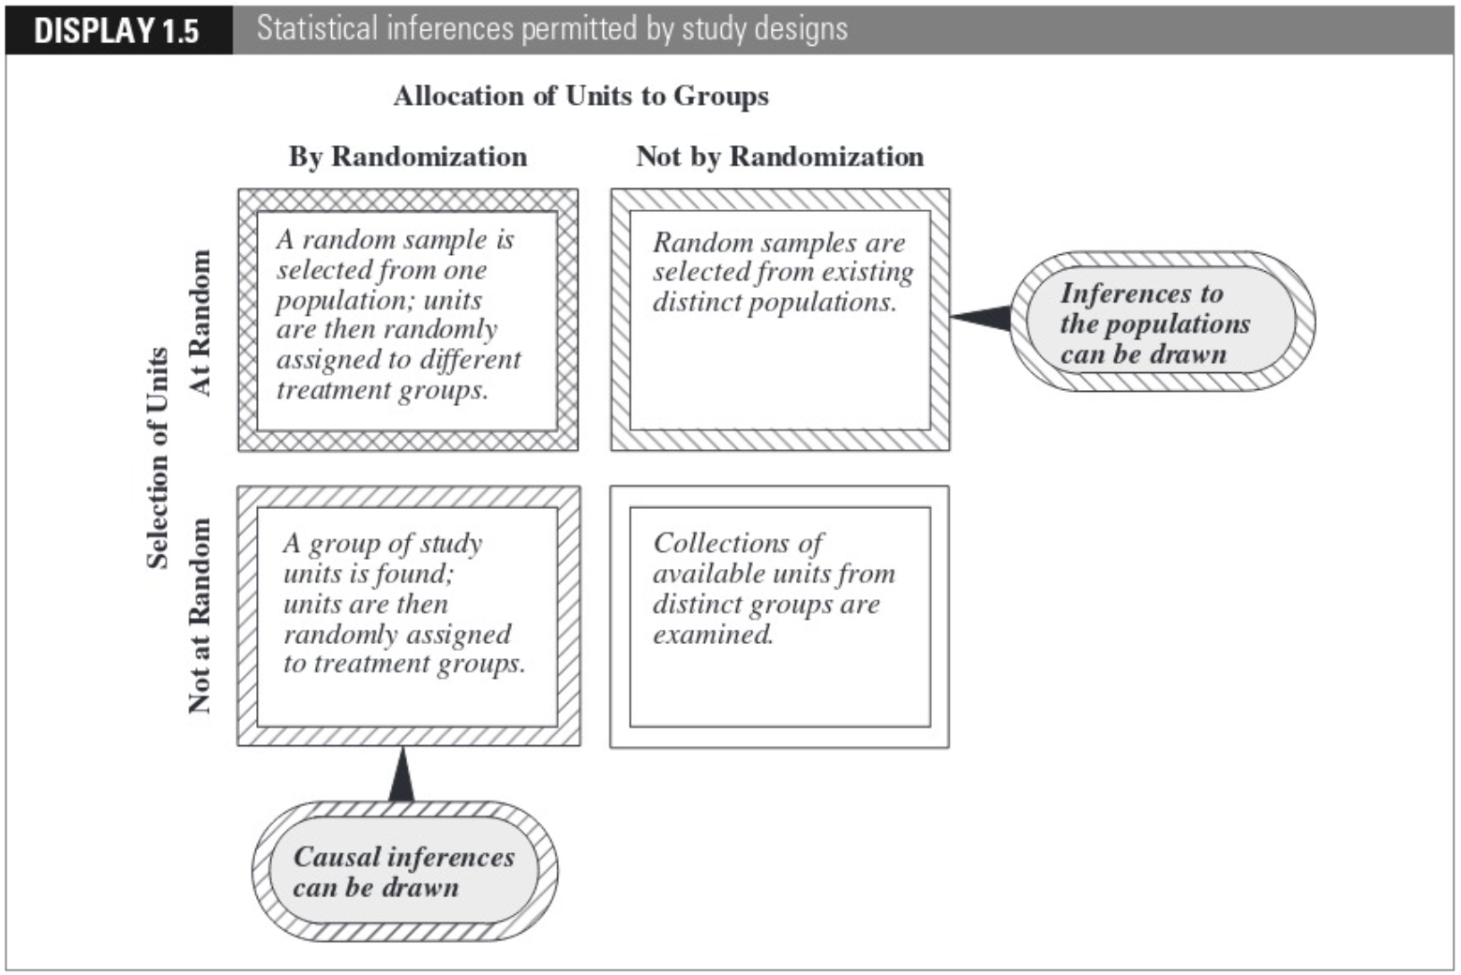
A diagram from stat 511

Slide 25
Why tell the types and roles of variables?

Slide 26

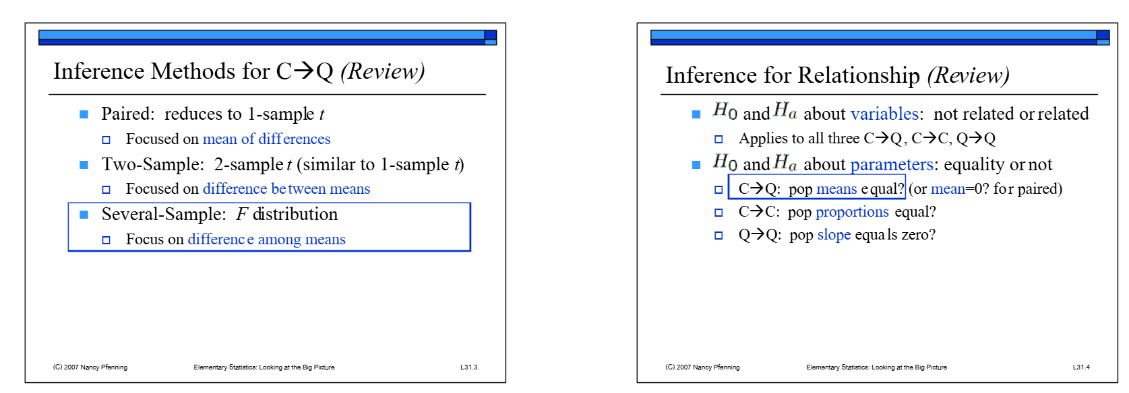


Slide 27
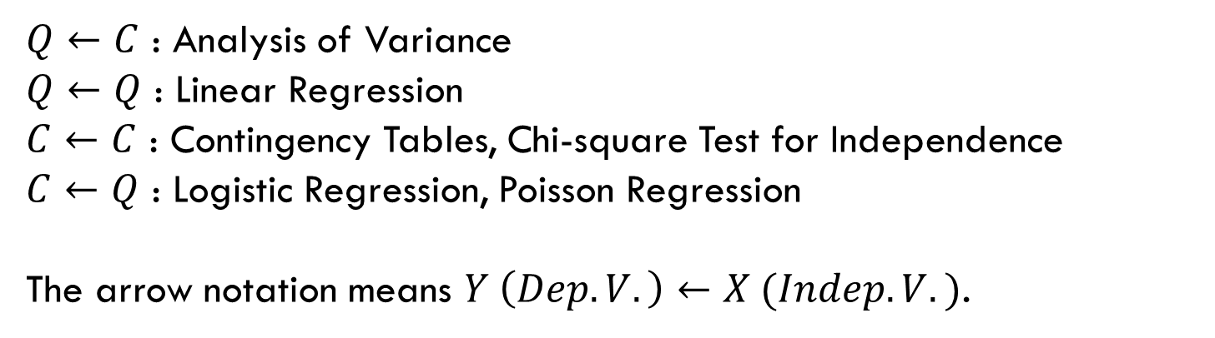
Why tell the types and roles of variables?
$Q←C$ : Analysis of Variance
$Q←Q$ : Linear Regression
$C←C$ : Contingency Tables, Chi-square Test for Independence
$C←Q$ : Logistic Regression, Poisson Regression
The arrow notation means $Y \left(Dep. V.\right)←X (Indep. V.)$.
Note: All of the above models are special cases of linear models (generalized linear models).

Slide 28

Quote of the day
“May we share our love even more abundantly with those who need us so desperately.”
https://www.churchofjesuschrist.org/study/general-conference/2025/04/21andersen?lang=eng

Slide 29
Typos?
Please email me any typos and errors you found in this lesson.
Thank you!

